Slide 1

Capstone Project
TO Open A NEW INDIAN RESTUARANT IN TORONTO, CANADA
-Jayeta Biswas

Slide 2

INTRODUCTION
Toronto is the capitol city of Ontario. It is the most populated city in Canada. It is the center for international business, finances, arts and cultural and it is recognized as multicultural cities in the world. The diverse population of Toronto reflects its current and historical role as an important destination for immigrants to Canada. Toronto has the largest Indian population in Canada. There are numerous opportunities for entrepreneurs to start a new business.

Slide 3

Problem
In this project, we are trying to find a best place to open a new Indian restaurant in Toronto, Canada. Since there are lots of restaurants in Toronto we will try to detect the locations that are not already crowded with restaurants and focusing mainly in areas where no Indian restaurant is in the neighborhood.

Slide 4
Target audience
Entrepreneur who wants to start a new business especially to open an Indian restaurant in Toronto and this will be an useful guide to start or expand restaurants targeting the Indian crowd.
Indian people who want to find a neighborhood with lots of option for Indian Restaurant.
This analysis definitely provides all the details required to open a restaurant and their pros and cons of this business.

Slide 5
data
Data source:
The neighborhoods of Toronto can be imported from the Wikipedia page "https://en.wikipedia.org/wiki/List_of_postal_codes_of_Canada:_M" and read into data frame.
Foursquare is used to find the number of restaurant and their location in each neighborhood, which helps us to find the best location for new Indian restaurants.
The geographical coordinates of all neighborhoods in Toronto can be obtained by using "https://cocl.us/Geospatial data"

Slide 6
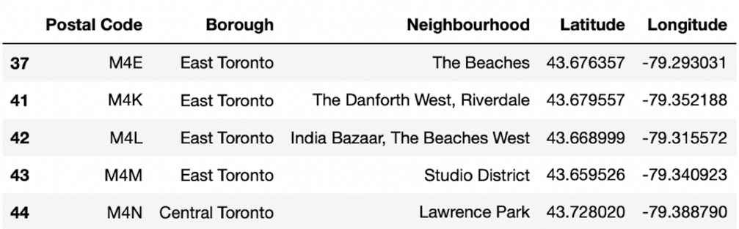
Toronto Dataset

Slide 7
methodology
Foursquare is a technology company that built a massive dataset of location data.
We create a uniform resource identifier, or URI, and append it with extra parameters depending on the data that we are seeking from the database.
. Any call request we make is composed of, we can call this base URI, which is api.foursquare.com/v2, and we can request data about venues, users, or tips. But, every time we make a call request, you have to pass our developer account credentials, which are your Client ID and Client Secret as well as what is called the version of the API, which is simply a date.

Slide 8
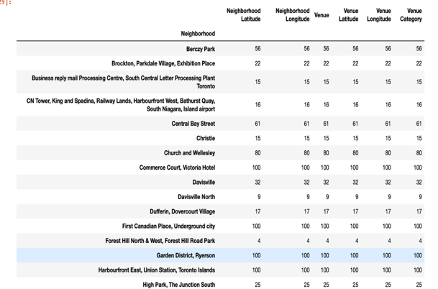
Explore neighborhood
By using Foursquare API, we will retrieve all the nearby venues information in Toronto like Restaurants, cafe, park etc.

Slide 9
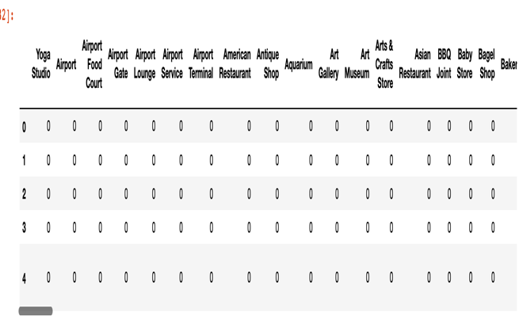
One hot coding technique
Categorical Data in the dataset is transformed into Numerical data by One hot coding technique. For each neighborhood, we convert individual venues into frequency to find how many venues are located in each neighborhood.

Slide 10
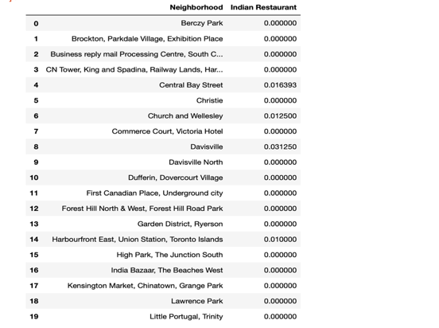
K mean clustering
We use K mean Clustering method to cluster all the neighborhood based on the average of Indian restaurants set K = 3.

Slide 11
Data Analysis
The cluster 1 and 3 has the least number of Indian restaurants. The neighborhoods in the cluster 1 are Harbourfront East, Union Station, Toronto Islands and the neighborhoods in cluster 3 are The Annex, North Midtown, Yorkville. The cluster 2 has highest number of neighborhoods with highest number of Indian restaurants.

Slide 12
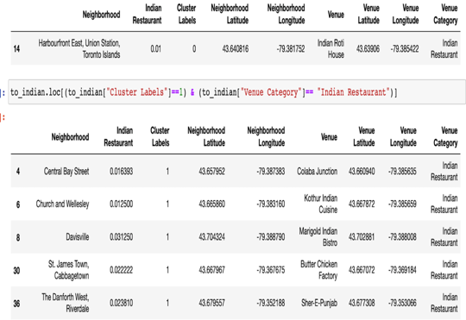
Cluster 0
The cluster 0 has Harbourfront East, Union Station, Toronto Islands neighborhoods with least number of Indian restaurants.

Slide 13
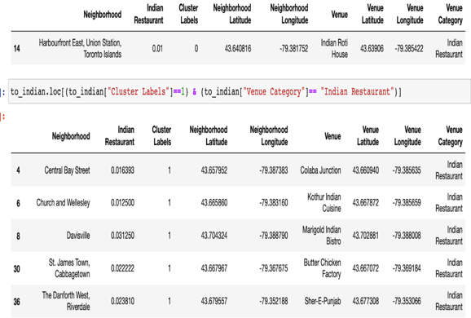
Cluster 1
The cluster 1 has highest number of neighborhoods with highest number of Indian restaurants.
The neighborhoods are Central Bay Street, church Wellesley, Davis Ville, St. Jamestown, Cabbage town,
The Danforth West, Riverdale. The highest average of Indian restaurants is 0.3125.

Slide 14
Cluster 2
The cluster 2 has The Annex, North Midtown, Yorkville with least number of Indian restaurants

Slide 15
result
. Toronto has 11 boroughs but Central Toronto, Downtown Toronto, East Toronto, East York, North York & Scarborough boroughs have a highest number of Indian restaurants.
We found that Downtown Toronto, Central Toronto, East York are populated with Indian restaurants’ we will ignore those neighborhoods.
Thus, North York and east Toronto would be the best place to start new Indian restaurants in Toronto, Canada. Theresfore, it is better to open new restaurants in Scarborough because it has high number of Indian population and low competition.

Slide 16
conclusion
Scarborough would be the best and least competition place for new Indian restaurants and also it is densely populated by Indians which provide high customer possibility.
Definitely this place would be the best place to open new Indian restaurants in Toronto, Canada.

